Slide 1
EXZELLENZ VERBINDET – BE PART OF A WORLDWIDE NETWORK
Carmen Gloria Feijoo
Scientific Ambassador
Alexander von Humboldt Foundation
12.06.2023
Foro Académico Chile-Alemania

Slide 2
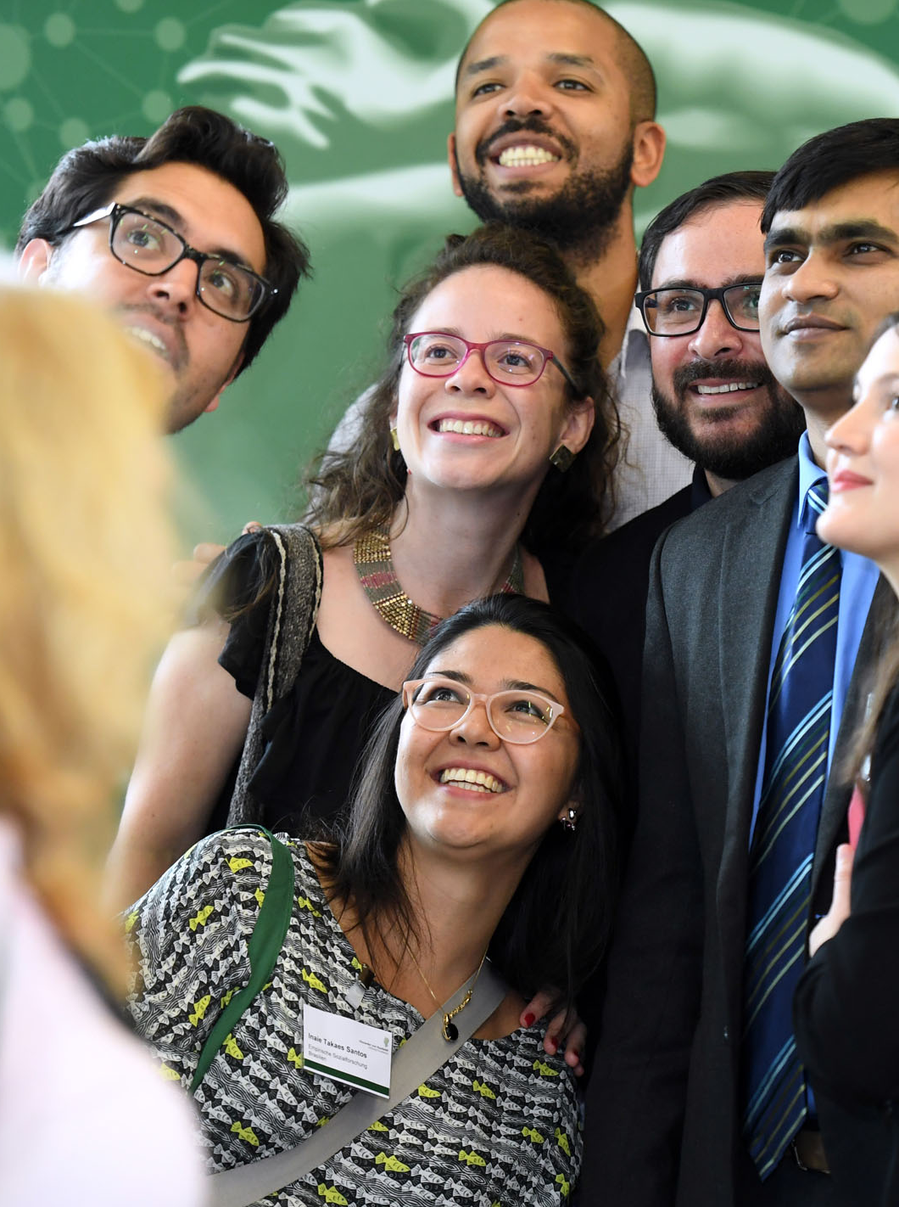
What do we do?
The Foundation awards research fellowships and prizes to researchers from abroad.
Carry out research project with a host (collaborative partner) in Germany.
2 | 11.06.23

Slide 3
What do we do?
There are no quotas, neither for countries nor for academic disciplines
What matters is the personal academic trajectory
We support people, not projects

Slide 4
Key Sponsorship Programm Humboldt Research Fellowship
For postdocs (up to 4 years after PhD)
research fellowship; 6 to 24 months; 2.670 € /month
For experienced researchers with a scientific profile of their own (up to 12 years after PhD)
research fellowship; 6 to 24 months; 3.170 € /month
Notes:
Der*die Gastgeber*in muss Mitglied des Humboldt-Netzwerks im Ausland sein.

Slide 5
REQUIREMENTS
Postdocs | Experienced researchers
Outstanding PhD, awarded no more than 4 years prior to the application date Internationally visible scientific publications agreed research position own research project knowledge of German or English | PhD. completed less than 12 years ago at the time of application own scientific activity, e.g. as an assistant professor extensive scientific publications with a recognizable profile of their own agreed research position own research project knowledge of German or English
Notes:
The requirements for an Alexander von Humboldt Foundation research fellowship are an above average doctorate or comparable academic qualification, independent research experience, documented by recognised academic publications, preferably in international journals, adequate language skills, a research outline agreed upon with the academic host as well as a confirmation of the host institute that research facilities are available.
As a rule, candidates’ chances are increased if they belong to the top group amongst their international peers. The number of publications considered appropriate varies according to discipline and career stage.
What determines whether an application is successful is academic quality, not German language skills. In science, in particular, working groups function and publish in English. In this case, it is not necessary to have a proven knowledge of German at the time of application.
Candidates from the humanities and social sciences, on the other hand, should have a basic knowledge of German, which may be necessary to conduct the project successfully, at the time of application.
Experienced researchers should have their own, clearly defined academic profile. This means they should usually be working at least at the level of Assistant Professor or Junior Research Group Leader or be able to document independent research work over a number of years and a comprehensive list of academic publications with a recognisable, independent profile.

Slide 6
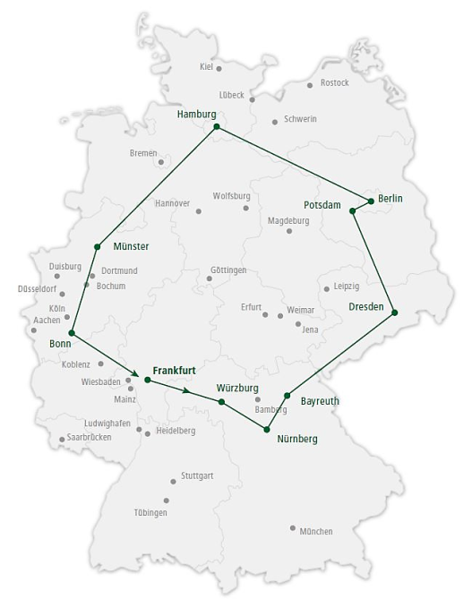
BENEFITS / ALLOWANCES
Fixed amount for travel expenses
Language courses
Family allowance
Subsidy of research expenses for host
institution
Study trip, annual meeting in Berlin,
networking events

Slide 7
INTERNATIONAL FELLOWSHIP FOR CLIMATE PROTECTION
For prospective leaders and postdocs from non-European emerging and developing countries
working in the field of climate protection
in non-governmental organizations, public administration, politics, science or economics,
and would like to carry out an individual project in cooperation with a host in Germany.

Slide 8
INTERNATIONAL FELLOWSHIP FOR CLIMATE PROTECTION
Requirements
bachelor's degree or comparable academic degree
leadership potential
extensive work experience in the subject area or a completed PhD degree
Benefits
scholarship for 12-24 months
introductory seminar, courses, final meeting
German language course (optional), fixed amount for travel expenses, supplements for the family, etc.

Slide 9
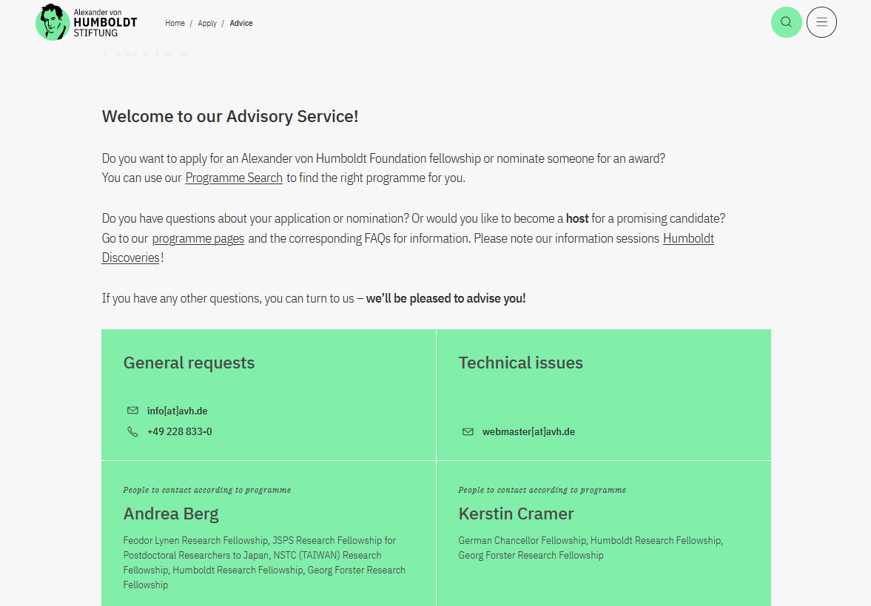
ASSISTANCE SERVICE
https://www.humboldt-foundation.de/en/apply/advice
info@avh.de
cfeijoo@unab.cl

Slide 10
IDEAS CAN ONLY BEAR FRUIT IF THEY TAKE ROOT IN MANY MINDS.
Alexander von Humboldt

