Slide 1
German Research Foundation
Deutsche Forschungsgemeinschaft DFG
- Funding Opportunities with Chile -
Dr. Gudrun Kausel
Opening Ceremony 1st Chile-Germany Academic Forum
12th june 2023, Salón de Honor Central Campus UC, Av. Libertador O´Higgins 340, 2nd floor, Santiago de Chile

Slide 2
DFG
Deutsche Forschungsgemeinschaft – DFG
German Research Foundation
the largest independent funding organization for curiosity-driven research in Germany,
member organisation, universities, non-university research institutions, ej. Max Planck, Helmholtz, academies of science
DFG
promote science and humanities in all branches
research projects
foster scientific excellence on a competitive base (peer review)
basic science
bottom up
advise parliament and public authorities on research questions
all topics
pay special attention to promotion and education of young scientists and researchers
at universities
encourage international scientific cooperation
support links between university and industry

Slide 3
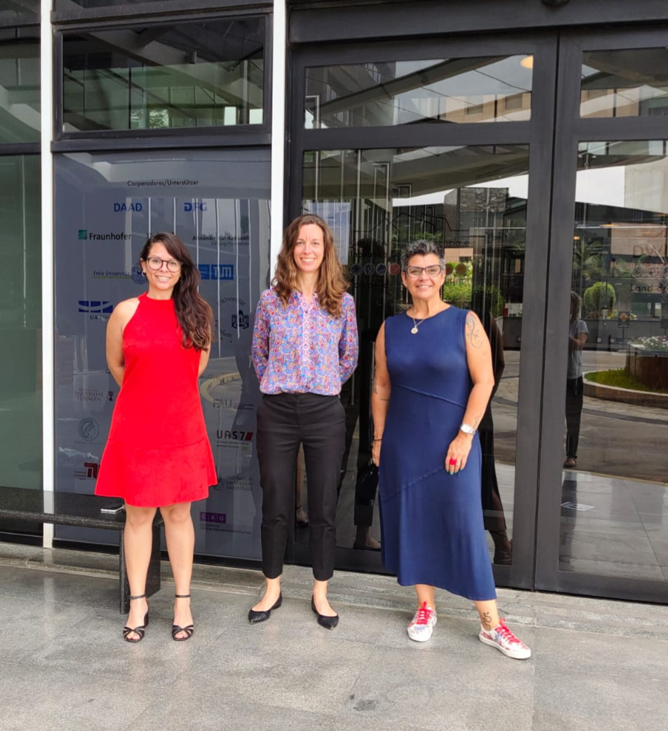
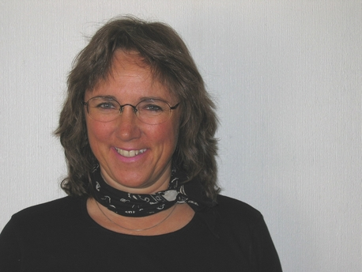
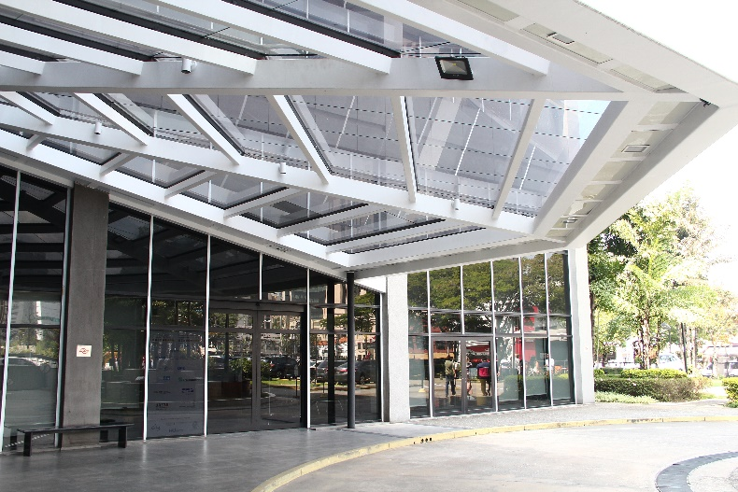
DFG-Office in Latin America (São Paulo) and Liaison Scientist Chile
OPPORTUNITY
Latin America’s scientific potential is growing
The region is becoming increasingly significant for science
Interest in cooperation with research partners in this region is growing considerably among German researchers
Increasing demand from Chilean researchers for next level cooperation
Prof. Dr. Gudrun Kausel,
Universidad Austral, Valdívia
DFG-Team São Paulo

Slide 4
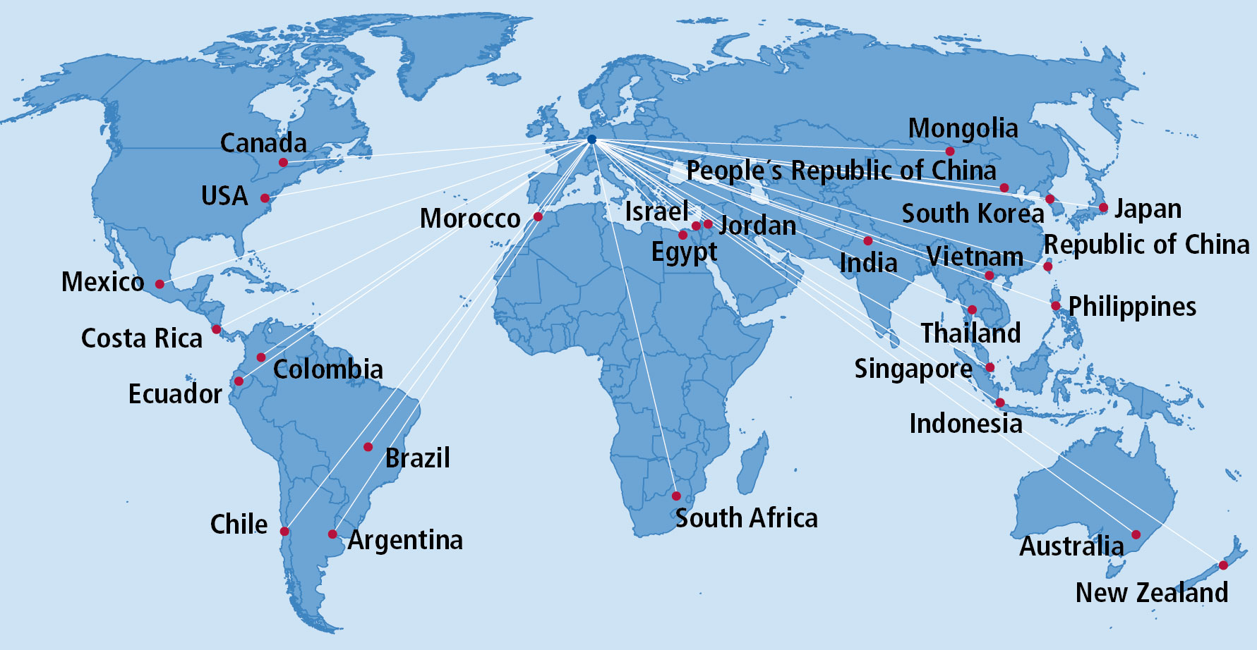
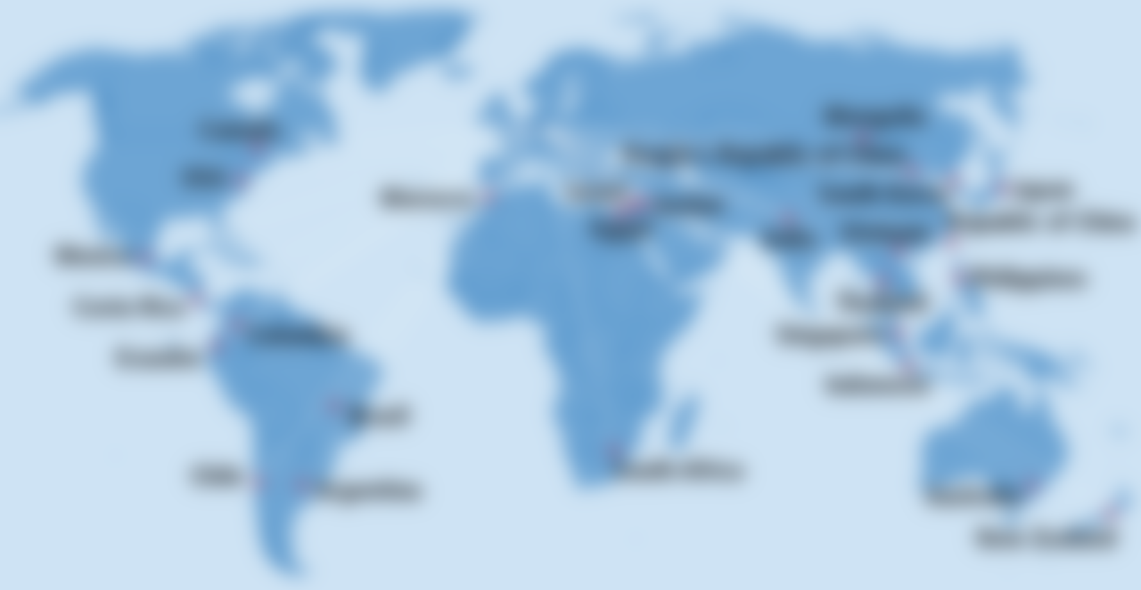
Our partner organizations
DFG has
15 partner organizations
in
7 countries
throughout Latin America
Notes:
Cooperation with Latin America has grown significantly over the last few years
Reasons:
Criteria-driven expansion of universities and research institutions as well as (junior) researcher support systems
Increasing internationalization of universities/research institutions (e.g. CAPES-PRINT in Brazil)
Increased perception of the Latin American science system in Germany (politics, science)
Joint funding mechanisms / programs have been established or adapted to enable funding in the context of research grants and coordinated funding program

Slide 5
International Cooperation with Chile
DFG Funding Statistics 2007 – 2022
Number of funded projects = 289
Total funding sum: 70,5 Million Euro

Slide 6
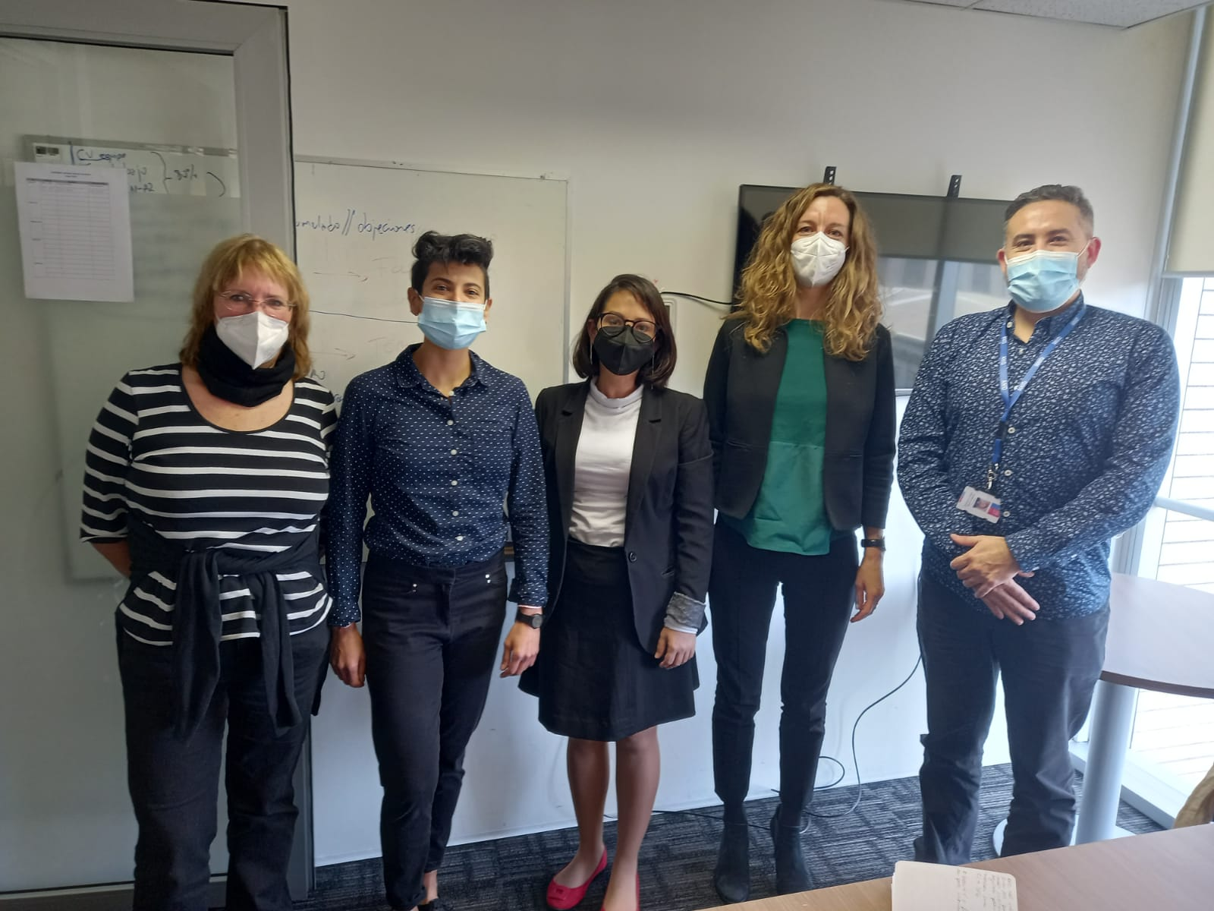
Opportunities for Collaboration
Joint funding for bilateral projects
Agencia Nacional de Investigación y Desarrollo (ANID) (ex CONICYT)
Cooperation agreement established in 1981 and renewed in 2002.
Principle of matching funds by DFG and the partner organization
Nov/2022: Joint Call for Projects between ANID & DFG
in specific areas:
Electrical Engineering and Information Technology
Astronomy and Astrophysics
22 submitted proposals, currently under evaluation
https://www.dfg.de/en/research_funding/faq/fag_international/index.html

Slide 7
DFG Programs and Future Perspectives
Initiation of International Cooperation, visits, bilateral workshop (DFG 1_813_en)
https://www.dfg.de/en/research_funding/programmes/international_cooperation/initiation_international_collaboration/
Joint research projects → OPEN to all areas
https://www.dfg.de/en/research_funding/funding_opportunities/international_cooperation/funding/index.html
- International Research Training Group IRTG → OPEN to PARTNERS
doctoral student training, 5-10 PI with their students on each side, up to 9 y. co-financing ANID, others, such as directly universities, research centers
ROAD MAP
REGULAR CALLS
LONG TERM JOINT FUNDING
agreements
joint research projects
SUSTAINABLE COOPERATION

Slide 8
Thank you for your attention!
Further information:
Contacts:
DFG Office Sao Paulo: christina.peters@dfg.de; latinamerica@dfg.de
DFG Liaison Officer Chile Prof. Dr. Gudrun Kausel: gkausel@uach.cl
DFG Headoffice Germany dietrich.halm@dfg.de
DFG websites: www.dfg.de; www.dfg.de/latinamerica or www.dfg.de/es
FAQs https://www.dfg.de/en/research_funding/faq/fag_international/index.html
DFG funded projects database GEPRIS https://gepris.dfg.de/gepris/OCTOPUS

